Slide 1

Sign up for IBM Cloud account: ibm.biz/covid-analysis
Battling against COVID-19 using AI and Data Science
— Anchal Bhalla Developer Advocate

Slide 2
Sign up for IBM Cloud account: ibm.biz/covid-analysis
Agenda
Data Science 03
Basic Concepts 03
Methodology 04
Watson Studio 05
Healthcare use case 9
Intro 9
Exploring the use case 11
Live coding session 19

Slide 3

Sign up for IBM Cloud account: ibm.biz/covid-analysis
What is Data Science?

Slide 4










Methodology
Sign up for IBM Cloud account: ibm.biz/covid-analysis
Clean Data
Analyze Data
External Data
Start
Build Model
Business Understanding
Data Processing
Train Model
Evaluate Model
Test Model
Deploy Application
Business Outcomes
Maintain

Slide 5
Watson Studio
Sign up for IBM Cloud account: ibm.biz/covid-analysis

Slide 6
















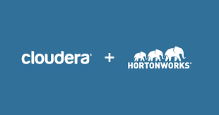






Watson Studio and Watson Machine Learning inject AI firepower into your business
Build and train at scale
Embed ML in your business
Authoring Tools
Operationalize
AutoAI
Decision Optimization
ML/DL Models
Python/R Functions
Data Pipelines
Notebooks
Machine Learning Runtimes
Deep Learning Runtimes
Deployment methods
Batch
Edge
Scalable & modern infrastructure
Hadoop Execution Engine
On x-86, Power + GPUs
Management & Monitoring
Version Control
Lineage
Automation
Watson Studio
Watson Machine Learning
Mix and Match your deployment
Cloud – IBM Cloud, Azure, AWS
On Premise / Private Data center
Desktop
On-prem
Notes:
Watson Studio and Watson Machine Learning inject AI firepower into your business
an environment that provides data science developers the tools needed to refine their data and then develop, train and deploy their models on the cloud.
We have a simple unified and end to end environment to address two stages of cycles
Build and train at scale
Embed ML in your businesses or projects
We set ourselves apart in many ways – one of the impactful ways we serve our clients is that we have flexible deployment – multi-cloud, on-premise / private data center and desktop
You can mix and match to meet your needs
Both worked to complete the data science lifecycle – that scales, can speed and is simple for you to inject AI firepower into your business
Let me explain Watson Studio and Watson Machine Learning in the next two slides.

Slide 7

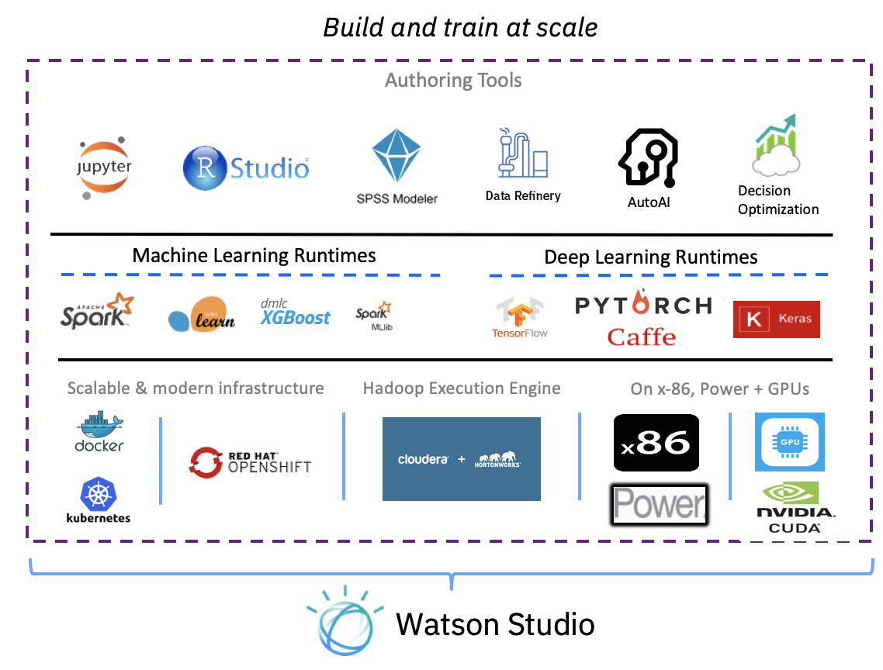
IBM Watson Studio
Enterprise Data Science platform that helps your team work together to build models to make better data driven decisions for your business
Analyze any data, no matter where it lives
Connect to and analyze your data without moving a single byte through dozens of connectors and multiple deployment options
Empower your entire organization with notebooks, visual productivity, and automation tools
Leverage your entire organization with a variety of tools in a single integrated platform
One platform to rule them all from discovery to production
Analyze data, build predictive models, and seamlessly integrate Watson Machine Learning to deploy at scale
Notes:
2. Empower your entire organization with open source integrated development environments (RStudio, Jupyter Notebooks), visual productivity, and automation tools
Lastly, everything is available one platform, its all integrated, you don’t need to switch between different tools and technologies to do different tasks from the methodology.
And this actually brings me to the industries actually using AI
Without having to move to a new database we have DS solution that will work for you – coud, local dektop, connectors
“we are not making money on where your data is hosted” – you don’t have to move your data
These are things I’m running into
Building upon previous slides what are we introducing today? Meets your wants while solving your problems
Low to high DS skills spectrum
How does WS fit into the trends – looking at BMC for cloud + WS → whatis our value to customer; how are we differentiating from SPSS Modeler?
30 min filling in BMC
30 mins which messages do we want to articulate given strwngths as offering and where we’re going
Goal: crisp & differrentiating
Okay so now diving a level deeper – and again each of these will go back to the 3 values we have on the board
WS = DS platform where your whole team can work together – meaning DS, LOB expert, business analyst, or anyone working on the DS platform – it’s very easy to bring all these people with different levels of expertise on the 1 platform of WS
The reason all these varying levels of expertise can work together is because of these tools you see on the right
DS are rare resources – they each have their own preferences of tools or languages that they want to work with so we have open source tools like R studio and Jupyter Notebooks where DS can come in and write their own code by choosing their own language (R, Scala, whatever they want), and go ahead and get started
At the same time, if someone is not really into coding but has the knowledge, they can use visual tools - like SPSS Modeler, Data Refinery, & Model Builder – where they have a drag and drop UI they can use to build a model normally and get predictions
Both sides are available in the same platform of Watson Studio.
You can give different access to different people.
The whole point is that WS really reduces the barrier between your resources and the DS journey – anyone can get started regardless of their expertise
→ which brings us back to the strategy of increasing your team productivity
You can see on the right, we provide different technologies and frameworks to support building models - you can use Spark or if you're working with Deep Learning we support all the other favorites so you can choose any of these and work on Studio
Let's say you're into deep learning, but you are not a coder, we have a drag & drop interface where you can build a deep learning model, expose that node, and use it in some other applications
We provide all these cutting edge infrastructure technologies so you can take advantage of any of them while you are working in WS
Again: easy, fast, and increases your team productivity
Again getting started very quickly to increase productivity

Slide 8
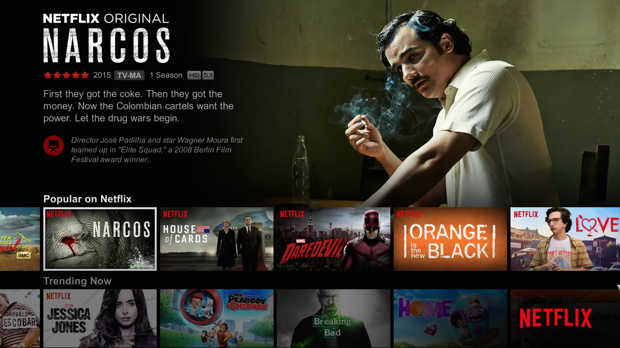
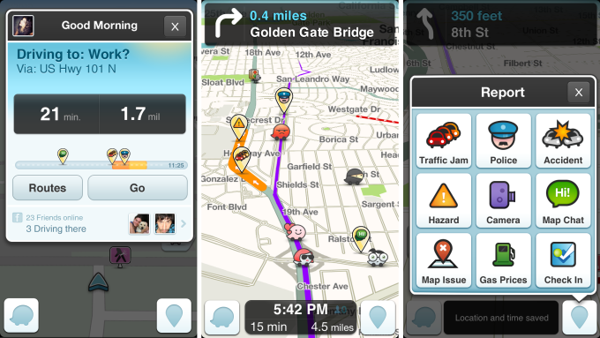
AI is Everywhere Influencing Everything We Do
Sign up for IBM Cloud account: ibm.biz/covid-analysis
1. Business Value
Netflix provides personalized recommendations
Waze provides a personalized driving experience
Uber delivers food that you like and is the right temperature
Self driving cars react to changing conditions
But ALL based on DATA and AI
Notes:
Does using Watson studio or any other tool solve any of the business problems out there? Well it is … you have seen and known many examples as well. So let me specifically point out some over here.
The point I want to make here really is that no matter which industry you are in – whether it be travel and transportation, food, delivery, service, or IT and high-tech – or you are in the business of managing and selling content like movies, AI is what ALL successful organizations are using.
The most disruptive new capability over the next decade”
85% believe AI will deliver competitive advantage
$39B in new AI investments in 2017
9.8x increase in demand for ML/AI skills
Artificial intelligence (AI) is no longer the future. For businesses, it is the here and now,
Whether it is Netflix who is using all of the data they have on movies, clients, etc. to provide personalizes recommendations for everybody, even with multiple people on an account. Or it is Waze who is able to understand traffic speeds, accidents, tolls, the speed limits and what other people are reporting along the road to determine the best route to get to where you want to go – based on any set criteria. Or Uber eats who use an algorithm to understand when to place an order with a restaurant so that it’s picked up and delivered at the right temperature making everybody happy. Or self driving cars that look at everything that surrounds the car and changing conditions.
Some of these are very successful - nobody can argue with Netflix or Waze or Uber. But some are not quite a successful, just got ask Google and their self driving car.
But everything, here all of these solutions and applications, are based on the data - Or ultimately the intelligence or AI that is applied to that data to make the right decisions and recommendations.

Slide 9



Sign up for IBM Cloud account: ibm.biz/covid-analysis
Covid-19 Trend Analysis and
Visualizations

Slide 10
Sign up for IBM Cloud account: ibm.biz/covid-analysis
General Statistics
3,610,006
253,381
Confirmed cases worldwide
Total fatalities worldwide
1,184,145
Total recovered worldwide

Slide 11



Sign up for IBM Cloud account: ibm.biz/covid-analysis
Business Challenge
What’s coming next? |
A pandemic as such leaves governments confused
Future planning |
How to plan out hospital supplies
A personalized dashboard |
No platform to customize and show results
11

Slide 12
Sign up for IBM Cloud account: ibm.biz/covid-analysis
DATA SCIENCE PIPELINE
The entire model building process
Data Collection
Data Preparation
Data Understanding
Deployment
Evaluation
Modelling

Slide 13
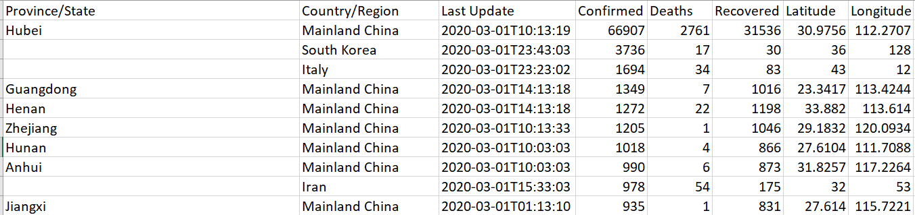
DATA COLLECTION & PREPARATION
Sign up for IBM Cloud account: ibm.biz/covid-analysis
Covid-19 data

Slide 14
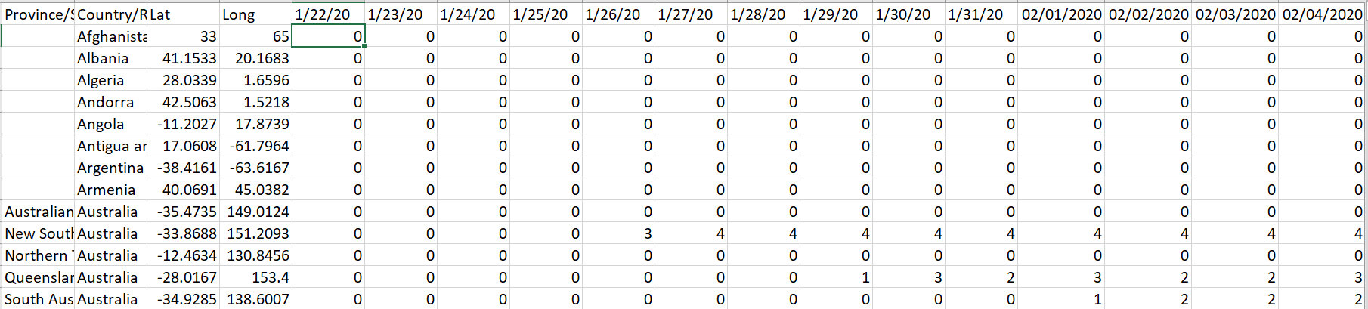
DATA COLLECTION & PREPARATION
Sign up for IBM Cloud account: ibm.biz/covid-analysis
Covid-19 data

Slide 15
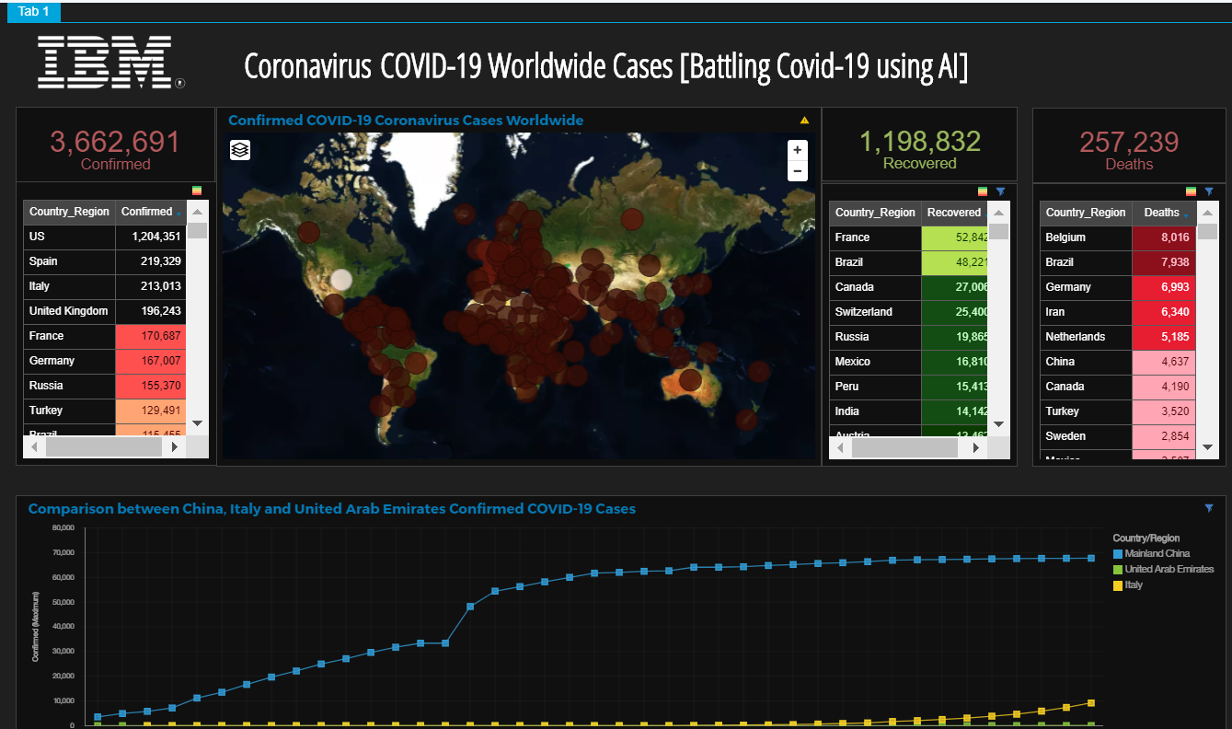
Data Understanding
Sign up for IBM Cloud account: ibm.biz/covid-analysis

Slide 16
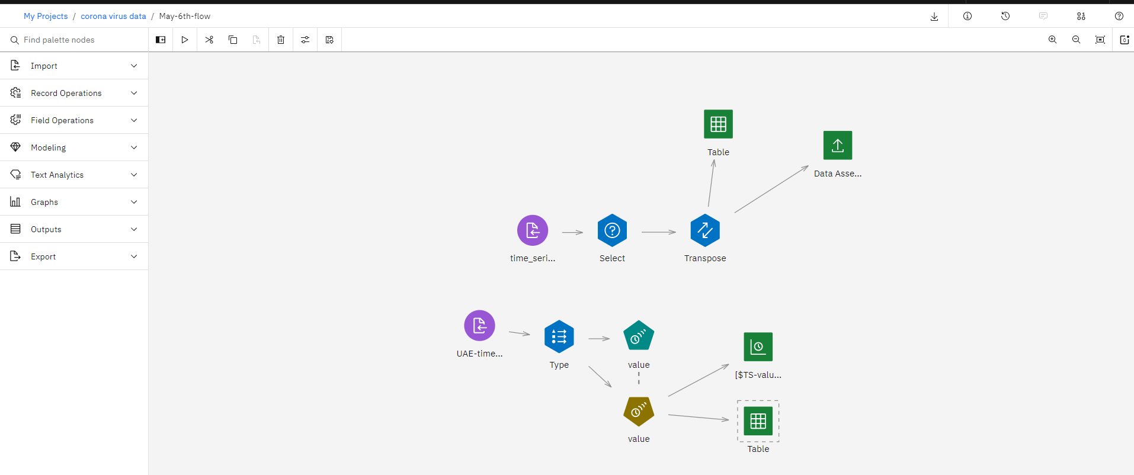
Modelling
Sign up for IBM Cloud account: ibm.biz/covid-analysis

Slide 17
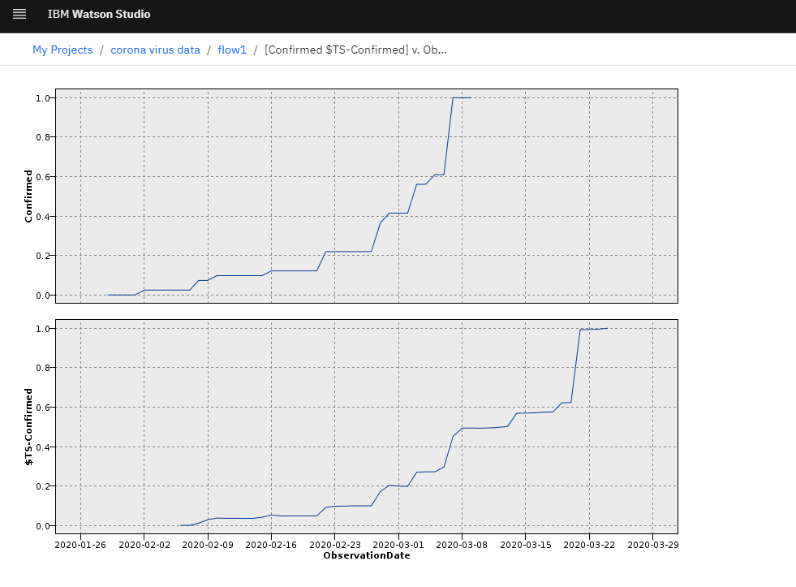
Modelling & Evaluation
Sign up for IBM Cloud account: ibm.biz/covid-analysis

Slide 18


Sign up for IBM Cloud account: ibm.biz/covid-analysis
ARCHITECTURE OVERVIEW
Behind the scenes of trend analysis of covid-19
Application
WML Model on Cloud or Premises (CP4D)
[driver analysis]
PREDICTION PAYLOAD

Slide 19
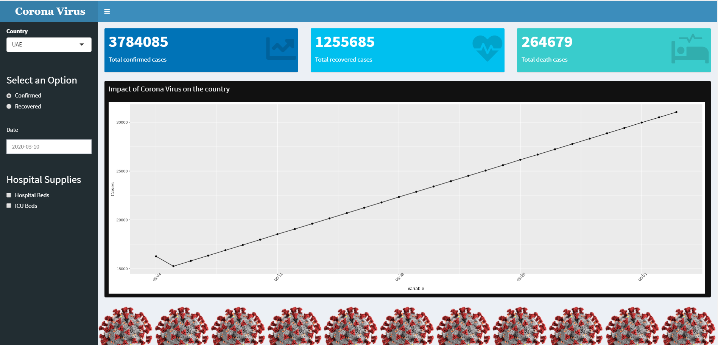
Application – Shiny app
Sign up for IBM Cloud account: ibm.biz/covid-analysis

Slide 20
Sign up for IBM Cloud account: ibm.biz/covid-analysis
LIVE DEMO
Useful links:
https://github.com/anchalbhalla/covid-analysis
http://ibm.biz/covid-analysis

Slide 21


Sign up for IBM Cloud account: ibm.biz/covid-analysis
Useful Links
Learn – develop – connect
IBM Developer (developer.ibm.com)
Red Hat courses (https://www.redhat.com/en/services/training/all-courses-exams)
Meetup Page (https://www.meetup.com/IBMDeveloperTR/)

Slide 22


